Slide 1
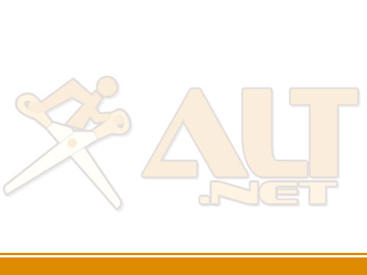

IoC and Testability

Slide 2


Speaker
Paul Cowan
Cutting-Edge Solutions (Scotland)
dagda1@scotalt.net
http://the-software-simpleton.blogspot.com/

Slide 3
Agenda
What is Inversion Of Control?
What defines testability (TDD)
IoC and Testability
Questions

Slide 4
What is Inversion
Of Control?

Slide 5
Problems with typical coding techniques
Glasgow ALT.NET User Group: http://tech.groups.yahoo.com/group/glasgow_altdotnet_usersgroup/

Slide 6
Tight Coupling
Notes:
Finish demo here.

Slide 7
The goals of good architecture
Don’t repeat yourself (DRY)
Separation of Concerns
Open, Closed Principle
Orthogonal Code
Favour Composition over Inheritance
Single Responsibility Pattern
Glasgow ALT.NET User Group: http://tech.groups.yahoo.com/group/glasgow_altdotnet_usersgroup/

Slide 8
What is Inversion
Of Control?

Slide 9
It is about the dependencies
Notes:
Finish demo here.

Slide 10
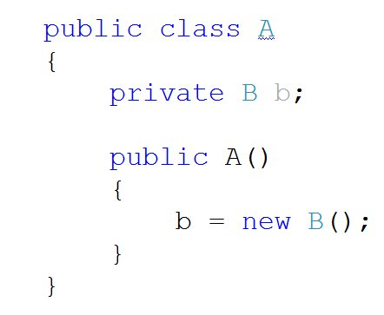
What is Inversion of Control?
1. Class A needs a reference to Class B
2. Class B is a concrete class that has a default constructor.
3. Class A owns an instance of class B.
4. Class A needs a reference to Class B
Glasgow ALT.NET User Group: http://tech.groups.yahoo.com/group/glasgow_altdotnet_usersgroup/

Slide 11
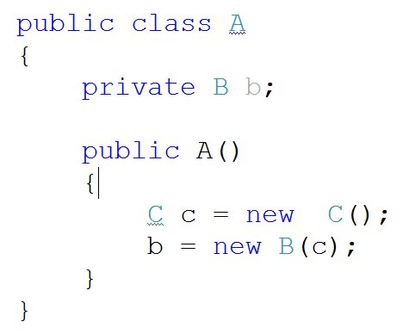
What is Inversion of Control?
1. You now need an instance of C in order to create B.
2. If class C or B changes then A needs to know about it.
Glasgow ALT.NET User Group: http://tech.groups.yahoo.com/group/glasgow_altdotnet_usersgroup/

Slide 12
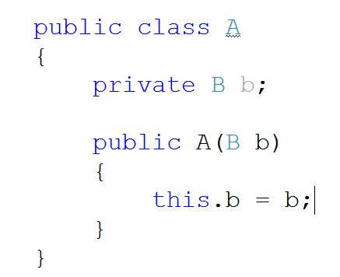
What is Inversion of Control?
1. An instance of B is now ‘injected’ into A.
2. A does not know how b was instansiated.
3. Responsibility of creating B moves from the object to the framework.
2. A does not know how b was instanciated.
Glasgow ALT.NET User Group: http://tech.groups.yahoo.com/group/glasgow_altdotnet_usersgroup/

Slide 13
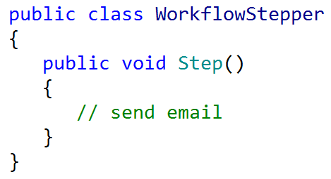
What is Inversion of Control?
Glasgow ALT.NET User Group: http://tech.groups.yahoo.com/group/glasgow_altdotnet_usersgroup/

Slide 14
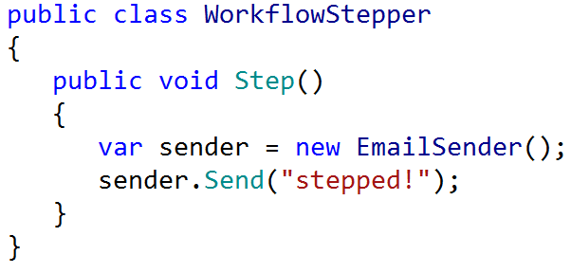
What is Inversion of Control?
Glasgow ALT.NET User Group: http://tech.groups.yahoo.com/group/glasgow_altdotnet_usersgroup/

Slide 15
Relationship is set at compile time.
Notes:
Finish demo here.

Slide 16
New is not always viable.
Notes:
Finish demo here.

Slide 17
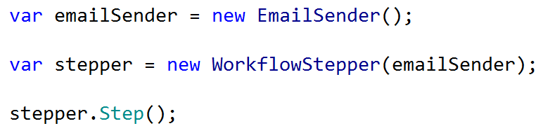
What is Inversion of Control?
Glasgow ALT.NET User Group: http://tech.groups.yahoo.com/group/glasgow_altdotnet_usersgroup/

Slide 18
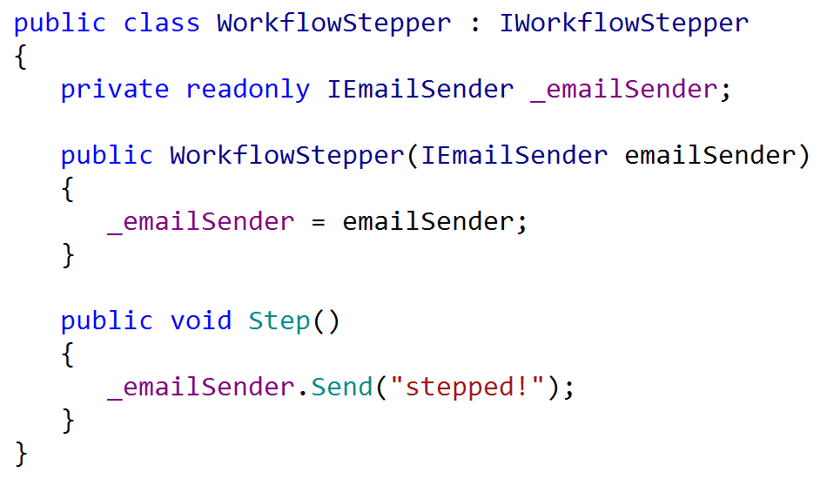
What is Inversion of Control?
Glasgow ALT.NET User Group: http://tech.groups.yahoo.com/group/glasgow_altdotnet_usersgroup/

Slide 19
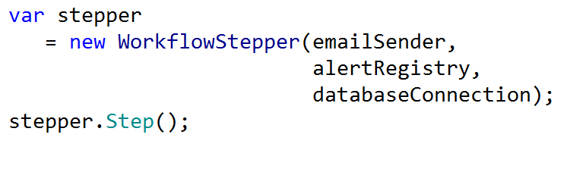
What is Inversion of Control?
Glasgow ALT.NET User Group: http://tech.groups.yahoo.com/group/glasgow_altdotnet_usersgroup/

Slide 20
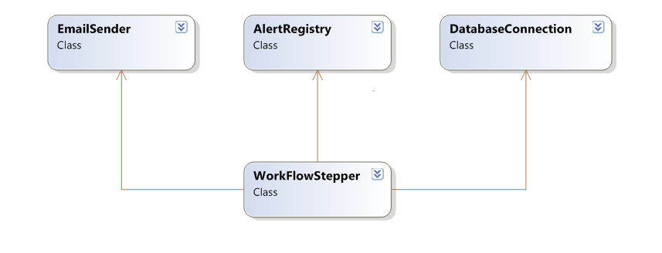
What is Inversion of Control?
Glasgow ALT.NET User Group: http://tech.groups.yahoo.com/group/glasgow_altdotnet_usersgroup/

Slide 21
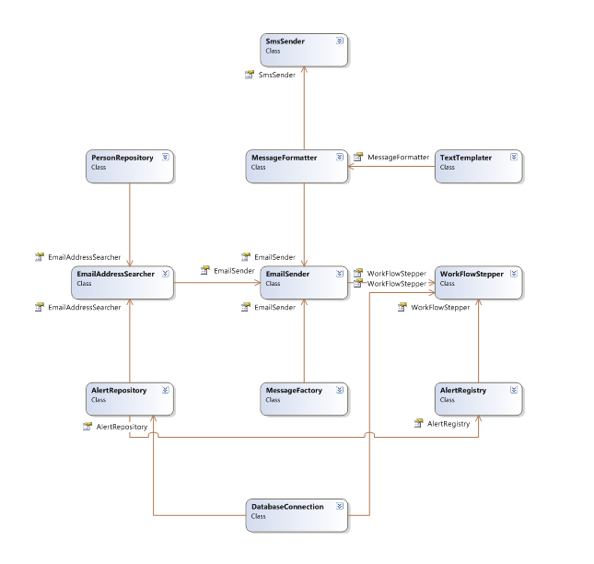

Slide 22
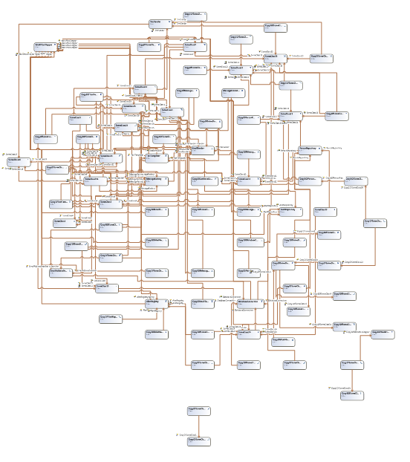

Slide 23
Show me the Code.
Notes:
Finish demo here.

Slide 24
Service Locator (Anti-pattern)
Glasgow ALT.NET User Group: http://tech.groups.yahoo.com/group/glasgow_altdotnet_usersgroup/

Slide 25
What is Inversion of Control?
Glasgow ALT.NET User Group: http://tech.groups.yahoo.com/group/glasgow_altdotnet_usersgroup/

Slide 26
What is Inversion of Control?
A way of designing reusable components
A way of decoupling services
‘Inject’ dependencies through constructor or parameters (Dependency Injection)
Technique to reduce coupling by moving configuration and dependency wiring outside a component.
Glasgow ALT.NET User Group: http://tech.groups.yahoo.com/group/glasgow_altdotnet_usersgroup/

Slide 27
Vocabulary
Service = Interface (IEmailSender)
Component = Class (EmailSender)
BUT
Not all classes are components
Glasgow ALT.NET User Group: http://tech.groups.yahoo.com/group/glasgow_altdotnet_usersgroup/

Slide 28
Components
Components must be composable
A Independently deployable
Make their context dependencies explicit.
Glasgow ALT.NET User Group: http://tech.groups.yahoo.com/group/glasgow_altdotnet_usersgroup/

Slide 29
IoC AND Dependency Injection
Inversion of Control
  A concept
  Relinquishing the responsibility of managing dependencies.
Dependency Injection
  A pattern
  Constructor injection
  Property injection
Glasgow ALT.NET User Group: http://tech.groups.yahoo.com/group/glasgow_altdotnet_usersgroup/

Slide 30
IoC design style
Systems are composed of small specialised services
  Represented by interfaces
Components declare
  The services they provide (by implementation)
  The services they require (by DI)
Components do not dictate their own lifestyle
  Do not implement singleton yourself
Let TDD drive your design
Glasgow ALT.NET User Group: http://tech.groups.yahoo.com/group/glasgow_altdotnet_usersgroup/

Slide 31
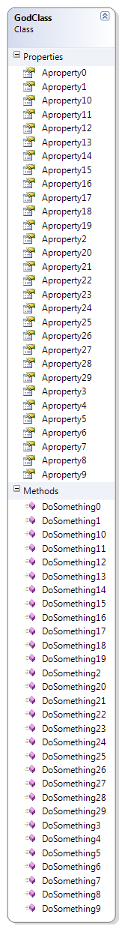
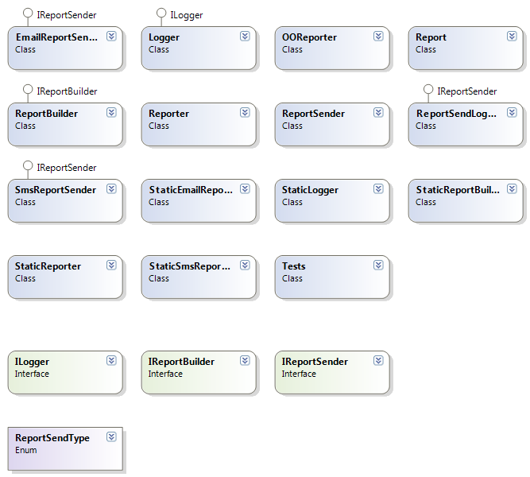
Break Large pieces into small
Glasgow ALT.NET User Group: http://tech.groups.yahoo.com/group/glasgow_altdotnet_usersgroup/

Slide 32
What is an IoC Container
A (very) smart factory
Automatically resolves dependencies
Automatically injects concrete instances
All services are registered in the container
Single point of access for services
Transparent
Various implementations for .NET
Glasgow ALT.NET User Group: http://tech.groups.yahoo.com/group/glasgow_altdotnet_usersgroup/

Slide 33
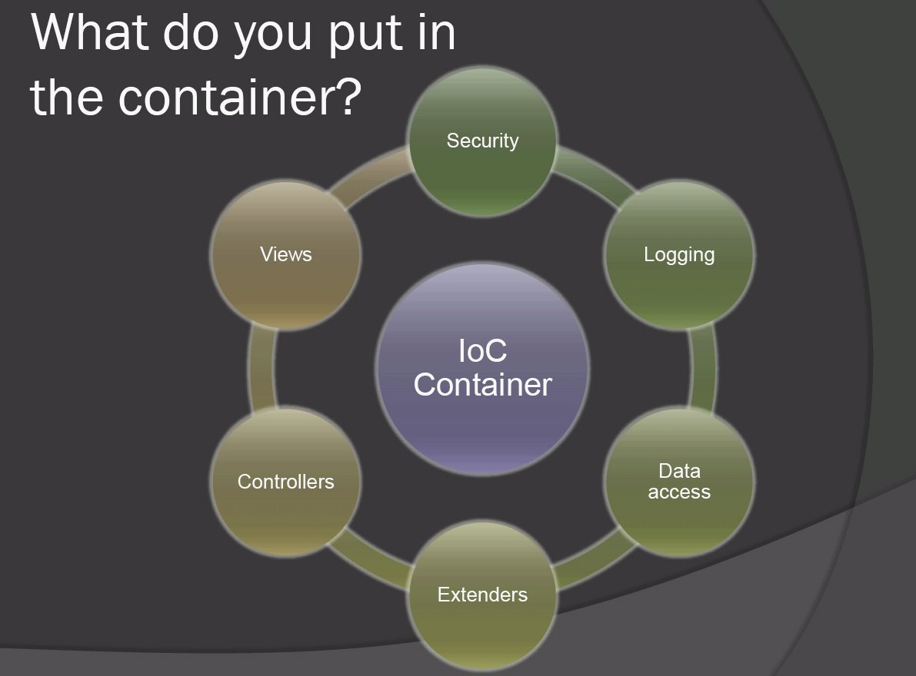
What is Invesion of Control?
Glasgow ALT.NET User Group: http://tech.groups.yahoo.com/group/glasgow_altdotnet_usersgroup/

Slide 34
Castle MicroKernel / Windsor
Part of the Castle Project castleproject.org
Started by Hamilton Verissimo
Also includes:
  MonoRail MVC framework for ASP.NET
  ActiveRecord based on NHibernate
Glasgow ALT.NET User Group: http://tech.groups.yahoo.com/group/glasgow_altdotnet_usersgroup/

Slide 35
Other Containers
Structuremap (http://structuremap.sourceforge.net/Default.htm)
Spring.NET (http://www.springframework.net/)
Autofac (http://code.google.com/p/autofac/)
Unity (http://codeplex.com/unity)
Glasgow ALT.NET User Group: http://tech.groups.yahoo.com/group/glasgow_altdotnet_usersgroup/
Glasgow ALT.NET User Group: http://tech.groups.yahoo.com/group/glasgow_altdotnet_usersgroup/

Slide 36
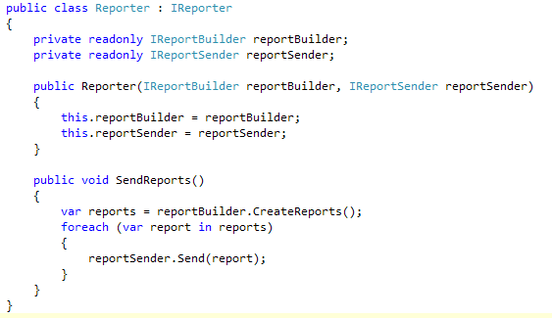
What is an IoC Container
Glasgow ALT.NET User Group: http://tech.groups.yahoo.com/group/glasgow_altdotnet_usersgroup/

Slide 37
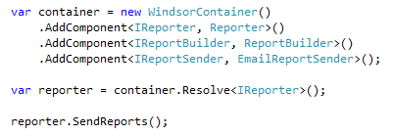
What is an IoC Container
Glasgow ALT.NET User Group: http://tech.groups.yahoo.com/group/glasgow_altdotnet_usersgroup/

Slide 38
There is no new
Notes:
Finish demo here.

Slide 39
Inversion of Control
Inversion Of Control, Dependency Injection, The Hollywood Principal etc.
Instead of instantiating concrete class references in your class, depend on an abstraction and allow your concrete dependencies to be given to you.
Glasgow ALT.NET User Group: http://tech.groups.yahoo.com/group/glasgow_altdotnet_usersgroup/

Slide 40
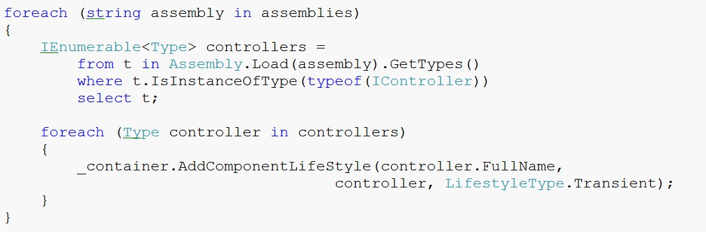
Auto-wiring Example
Glasgow ALT.NET User Group: http://tech.groups.yahoo.com/group/glasgow_altdotnet_usersgroup/

Slide 41
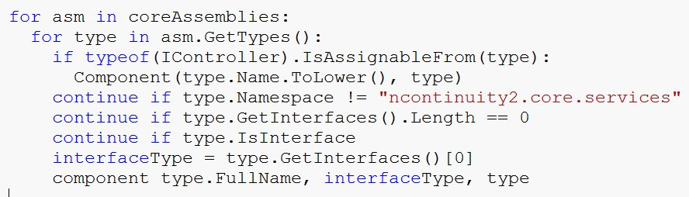
Binsor
Glasgow ALT.NET User Group: http://tech.groups.yahoo.com/group/glasgow_altdotnet_usersgroup/

Slide 42
Lifestyles
Singleton (the default)
Transient
Per Thread
Pooled
Per Web Request
Custom
Glasgow ALT.NET User Group: http://tech.groups.yahoo.com/group/glasgow_altdotnet_usersgroup/

Slide 43
Pros?
Simpler component architecture
Reduced cost of change
Easy to unit test
Easily move between application configurations
Ready made configuration (IoC containers)
Glasgow ALT.NET User Group: http://tech.groups.yahoo.com/group/glasgow_altdotnet_usersgroup/

Slide 44
Cons?
Not another thing to learn?
Higher level of abstraction
Performance?
Lifestyle mistakes can be hard to diagnose
Can’t do obfuscation and configuration
Maybe it’s time we looked at dynamically typed languages?
Glasgow ALT.NET User Group: http://tech.groups.yahoo.com/group/glasgow_altdotnet_usersgroup/

Slide 45
Should I use it?
Already familiar with OO principles and patterns?
Already writing unit tests?
Using a statically typed language?
If not, learn how to do these first
Don’t impose an IoC container on a team which can’t see its benefit
Glasgow ALT.NET User Group: http://tech.groups.yahoo.com/group/glasgow_altdotnet_usersgroup/

Slide 46
Advanced Usage
Facilities
Facilities supplement the IOC with a new technology
Transaction Facility
[Transaction(TransactionMode.RequiresNew)]
public CallTree MoveContact(Guid responderUid, Guid replacementUid)
{
}
NHibernate Facility
Interceptors
public void Intercept(IInvocation invocation)
{
MethodInfo methodInfo = invocation.MethodInvocationTarget;
if ((methodInfo == null) || (!_metaInfo.Contains(methodInfo)))
{
invocation.Proceed();
return;
}
Glasgow ALT.NET User Group: http://tech.groups.yahoo.com/group/glasgow_altdotnet_usersgroup/

Slide 47
Castle WCF Facility
Glasgow ALT.NET User Group: http://tech.groups.yahoo.com/group/glasgow_altdotnet_usersgroup/

Slide 48
Test Driven Development

Slide 49
What is a “Unit Test”
It’s a design method
The purpose of the tests in TDD is to drive out the design of the system.
You write a test before writing the code in order to clarify in your mind what the code should do when you write it?
Glasgow ALT.NET User Group: http://tech.groups.yahoo.com/group/glasgow_altdotnet_usersgroup/

Slide 50
TDD Myths
Myth
Truth
It’s a QA technique
It’s a development approach
It’s a substitute to design & modelling,
traditional QA
Its orthogonal to design &
modelling traditional QA
It curtails productivity
Most who apply it consider it a
productivity technique but the
the jury is still out
Glasgow ALT.NET User Group: http://tech.groups.yahoo.com/group/glasgow_altdotnet_usersgroup/

Slide 51
TDD Myth
TDD results in a regression test suite
Myth because
You may be using an application framework or 3rd party component
You may be working on a legacy system
You may not have adequate tool support for UI testing or database testing.
Glasgow ALT.NET User Group: http://tech.groups.yahoo.com/group/glasgow_altdotnet_usersgroup/

Slide 52
TDD Myth
TDD automatically produces quality code
Myth because
An inexperienced developer using TDD can still produce low quality code.
A development group will still need code reviews or other mechanisms to ensure code quality
Glasgow ALT.NET User Group: http://tech.groups.yahoo.com/group/glasgow_altdotnet_usersgroup/

Slide 53
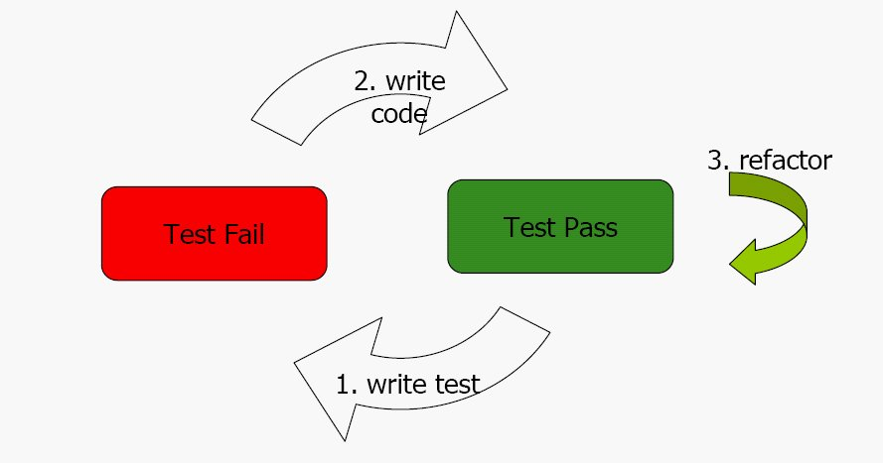
TDD Cycle
Glasgow ALT.NET User Group: http://tech.groups.yahoo.com/group/glasgow_altdotnet_usersgroup/

Slide 54
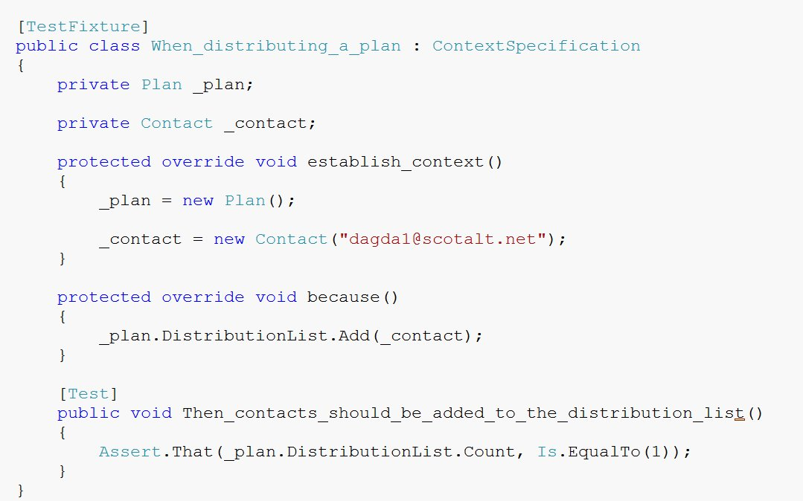
Unit test example
Glasgow ALT.NET User Group: http://tech.groups.yahoo.com/group/glasgow_altdotnet_usersgroup/

Slide 55
Properties of a good unit test
They run fast
They run in isolation
They provide documentation in the form of examples of how to invoke components of the system.
They represent progress towards the solution
Glasgow ALT.NET User Group: http://tech.groups.yahoo.com/group/glasgow_altdotnet_usersgroup/

Slide 56
Pure Unit Tests
A test is not “pure” if it
Talks to the database
It communicates across the network
It touches the file system
All “pure" unit tests for a system can be run many times a day as part of the TDD cycle.
Glasgow ALT.NET User Group: http://tech.groups.yahoo.com/group/glasgow_altdotnet_usersgroup/

Slide 57
TDD Guidelines
If you cannot test code – change it so you can
Test first
Only one concrete class per test – MOCK THE REST
Glasgow ALT.NET User Group: http://tech.groups.yahoo.com/group/glasgow_altdotnet_usersgroup/

Slide 58
Mocking
Mock objects are simulated objects that mimic the behaviour of real objects in controlled ways.
A computer programmer typically creates a mock object to test the behaviour of some other object.
Glasgow ALT.NET User Group: http://tech.groups.yahoo.com/group/glasgow_altdotnet_usersgroup/

Slide 59
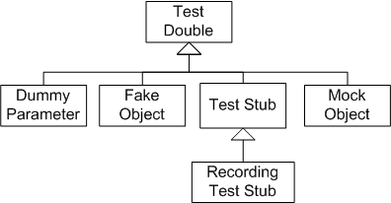
Mocking
Glasgow ALT.NET User Group: http://tech.groups.yahoo.com/group/glasgow_altdotnet_usersgroup/

Slide 60
Rhino Mocks 3.5
Main feature of 3.5 is the AAA syntax
Arrange or set up the test scenario
Act or carry out the functionality
Assert that our expectations are true
Glasgow ALT.NET User Group: http://tech.groups.yahoo.com/group/glasgow_altdotnet_usersgroup/

Slide 61
How to write good TDD specifications
What is the next important thing the system doesn’t do
Template for TDD scenarios
Given some initial context
When an event occurs
Then ensure some outcomes
Glasgow ALT.NET User Group: http://tech.groups.yahoo.com/group/glasgow_altdotnet_usersgroup/

Slide 62
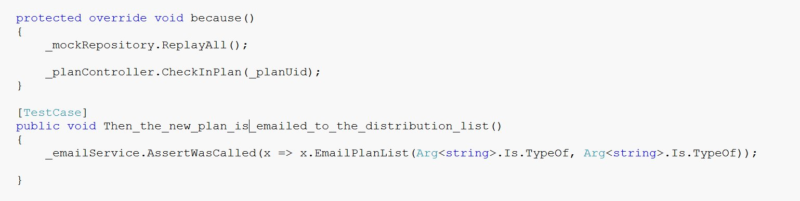
Example
Glasgow ALT.NET User Group: http://tech.groups.yahoo.com/group/glasgow_altdotnet_usersgroup/

Slide 63
TDD Encourages
DRY – Don’t repeat yourself
KISS – Keep It Simple Stupid
YAGNI – You Aint Going To Need It
SRP – Single Responsibility Pattern
IOC – Inversion Of Control
Glasgow ALT.NET User Group: http://tech.groups.yahoo.com/group/glasgow_altdotnet_usersgroup/

Slide 64
Epilogue

Slide 65
Any Questions ?

Slide 66


